Slide 1


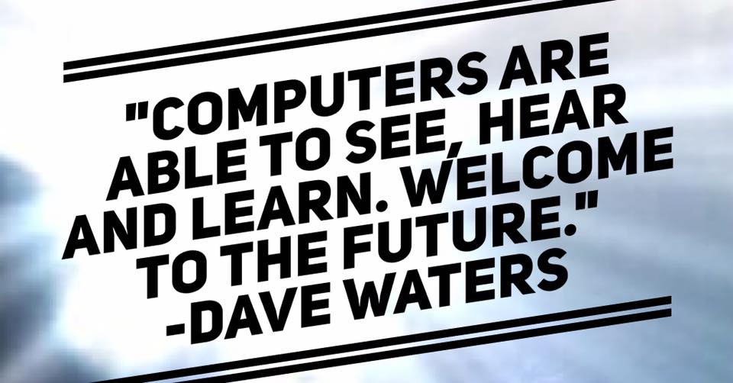
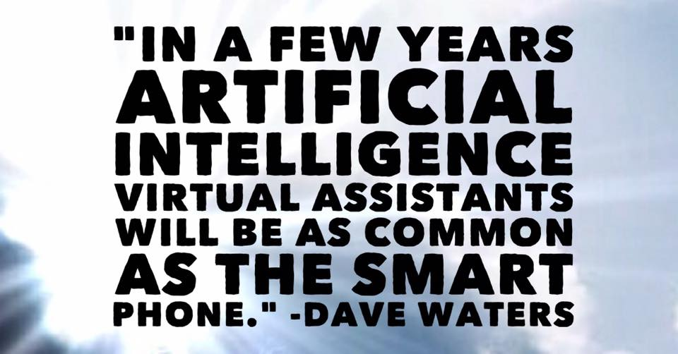
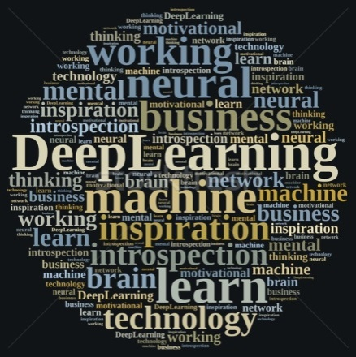
DeepBio 2018
CONVOLUTIONAL NEURAL NETWORKS FOR BIO-MEDICAL IMAGE PROCESSING
Mr. R. Vinaykumar (Research Scholar)
Mrs. V. Sowmya (Assistant Professor)
Dr. K. P. Soman (Professor & Head)
17-01-2018.

Slide 2
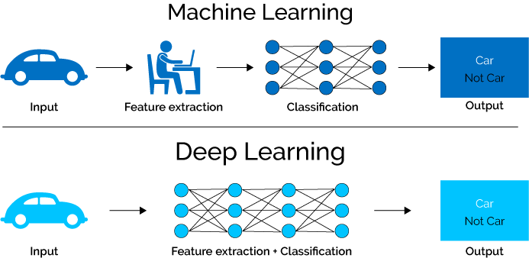

DeepBio 2018
WHY DEEP LEARNING?
CNN FOR BIO-MEDICAL IMAGE PROCESSING

Slide 3
DeepBio 2018
WHY DEEP LEARNING FOR MEDICAL DIAGNOSIS?
Deep Learning is a Black Box, but Health Care Won’t Mind
New algorithms are able to diagnose disease as accurately as expert physicians
-Monique Brouillette , MIT Technology Review , April 2017.
CNN FOR BIO-MEDICAL IMAGE PROCESSING

Slide 4

DeepBio 2018
Architecture
Input
Convol 1
Max Pool 1
Convol 2
FC
Output
Filter 1
Filter 2
CNN FOR BIO-MEDICAL IMAGE PROCESSING

Slide 5
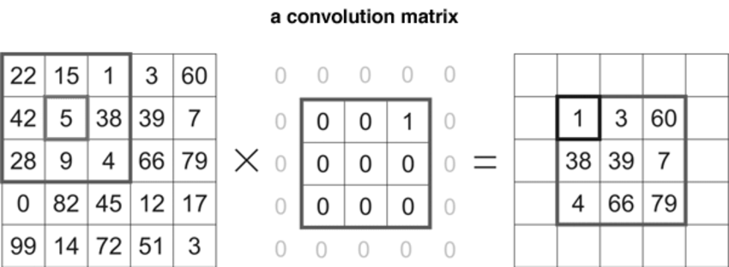
DeepBio 2018
CNN FOR BIO-MEDICAL IMAGE PROCESSING

Slide 6
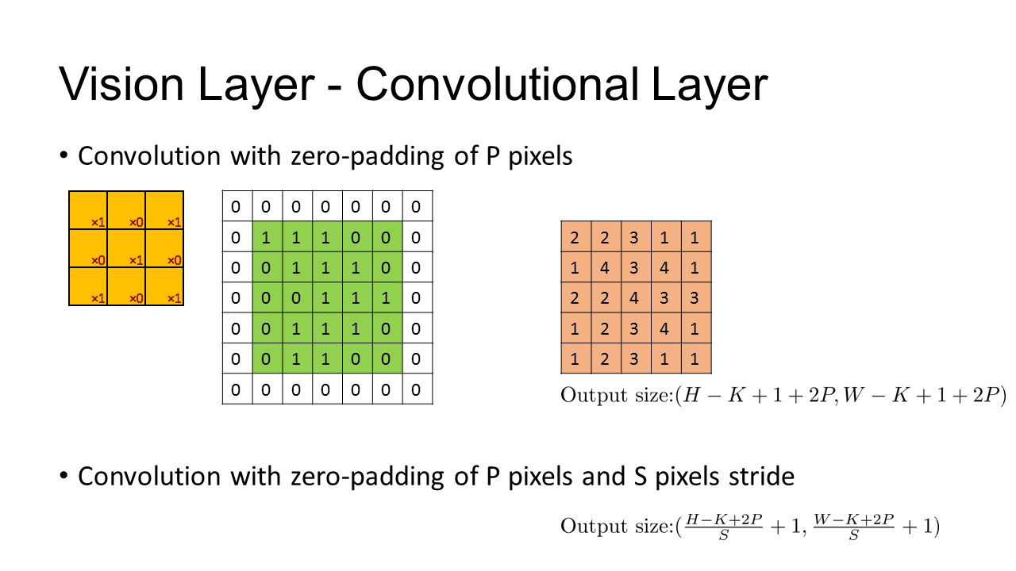

Slide 7
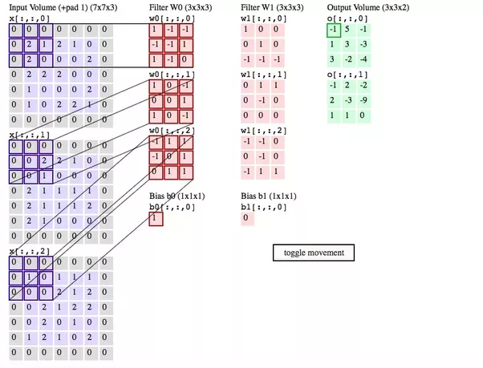

Slide 8
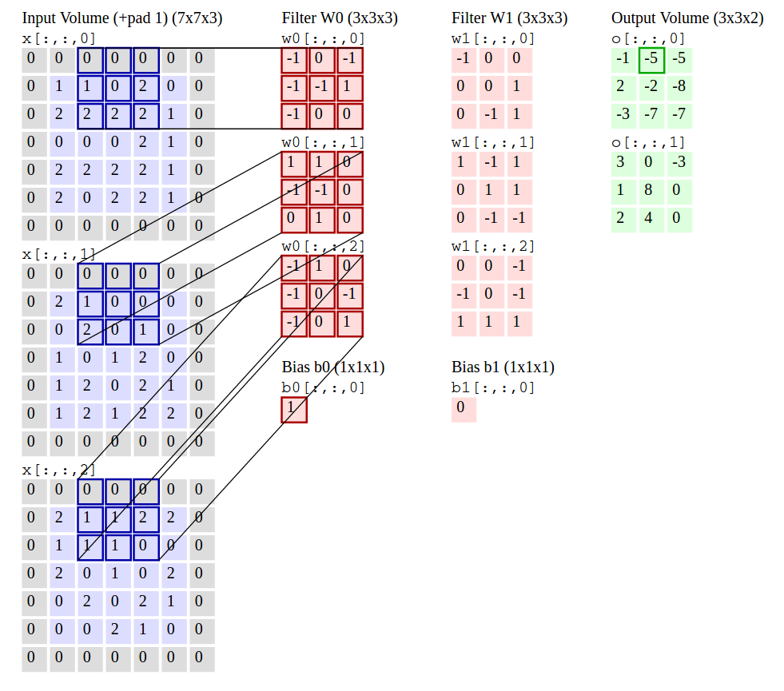

Slide 9
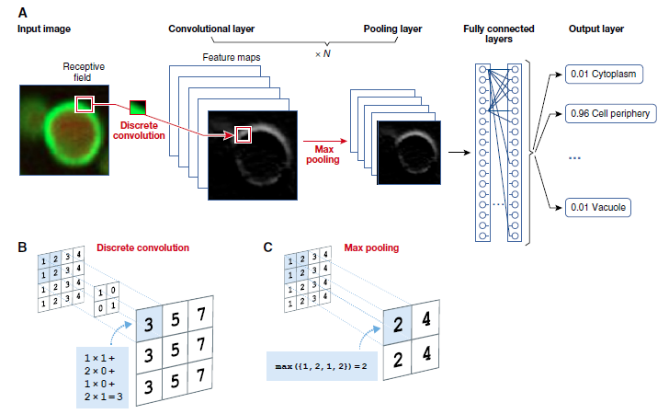

Slide 10
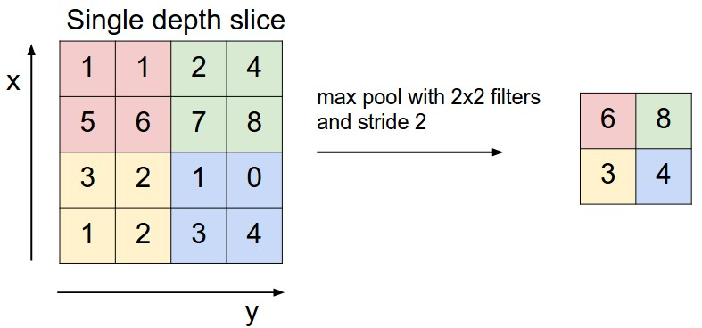
DeepBio 2018
CS231n: Convolutional Neural Networks for Visual Recognition.
CNN FOR BIO-MEDICAL IMAGE PROCESSING

Slide 11
DeepBio 2017
Architecture
M x M x 3
C1 x C1 x N1
P x P x N1
C2 x C2 x N2
FC
Output
N1 - F1 x F1 x 3
N2 – F2 x F2 x N1
C1 = ( (M-F1+2Z)/S1)+1
P1 = C1/PS
C2 = ( (P-F2+2Z)/S2)+1
CNN FOR BIO-MEDICAL IMAGE PROCESSING

Slide 12
DeepBio 2018
Architecture – TB & ML
20 x 20 x 3
18 x 18 x 7
9 x 9 x 7
8 x 8 x 12
100
2
7 - 3 x 3 x 3
12 – 2 x 2 x 7
C1 = ( (20-3+0)/1)+1
P1 = 18/2
C2 = ( (9-2+0)/1)+1
DEEP CNN FOR MICROSCOPY BASED POINT OF CARE DIAGNOSTICS – John A. Quinn et al., ICMLHC, 2016.

Slide 13
DeepBio 2018
CONVOLUTION
CNN FOR BIO-MEDICAL IMAGE PROCESSING

Slide 14
DeepBio 2018
CONVOLUTION

Slide 15
DeepBio 2018
CONVOLUTION
CNN FOR BIO-MEDICAL IMAGE PROCESSING

Slide 16
DeepBio 2018
CONVOLUTION
CS231n: Convolutional Neural Networks for Visual Recognition.
CNN FOR BIO-MEDICAL IMAGE PROCESSING

Slide 17
DeepBio 2018
MICROSCOPY DIAGNOSIS
* Low-resources
CHALLENGES:
Skilled Technicians
Critical Shortage
CONSEQUENCES:
error –prone
economic burden of buying unnecessary drugs
DEEP CNN FOR MICROSCOPY BASED POINT OF CARE DIAGNOSTICS – John A. Quinn et al., ICMLHC, 2016.

Slide 18
DeepBio 2018
MOTIVATION
Common resources: Microscopes and smartphones.
Automation with computer vision methods.
DEEP CNN FOR MICROSCOPY BASED POINT OF CARE DIAGNOSTICS – John A. Quinn et al., ICMLHC, 2016.

Slide 19
DeepBio 2018
OBJECTIVE
Development of point-of-care (POC) diagnostics which utilize two relatively common resources: microscopes and smartphones.
DEEP CNN FOR MICROSCOPY BASED POINT OF CARE DIAGNOSTICS – John A. Quinn et al., ICMLHC, 2016.

Slide 20
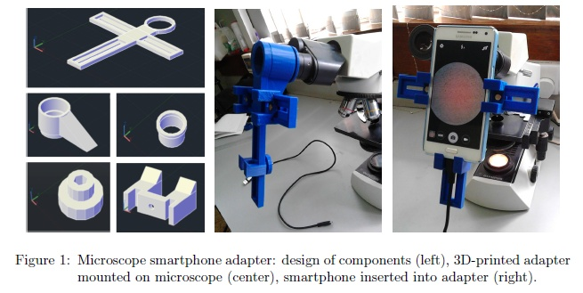
DeepBio 2018
HARDWARE DESIGN
Hardware Design
DEEP CNN FOR MICROSCOPY BASED POINT OF CARE DIAGNOSTICS – John A. Quinn et al., ICMLHC, 2016.

Slide 21
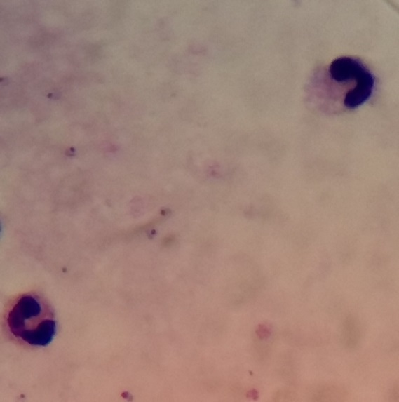
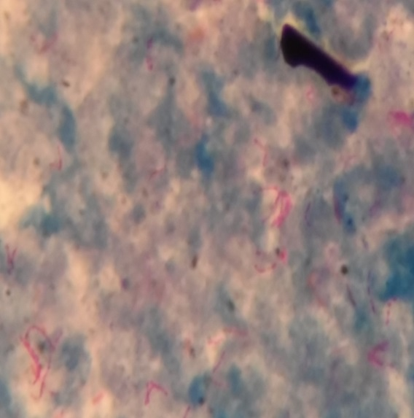
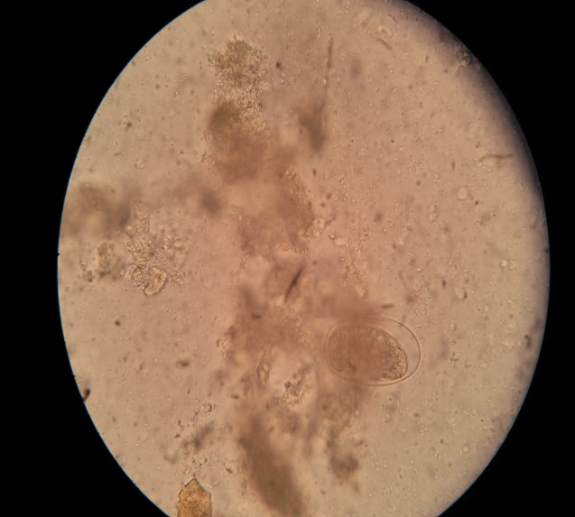
DeepBio 2018
DATASET
Malaria (ML)
Tuberculosis (TB)
Intestinal parasites (IP)
7245 patches in 1182 images
3734 patches in 928 images
162 patches in 1217 images
DEEP CNN FOR MICROSCOPY BASED POINT OF CARE DIAGNOSTICS – John A. Quinn et al., ICMLHC, 2016.

Slide 22
DeepBio 2018
Architecture – TB & ML
20 x 20 x 3
18 x 18 x 7
9 x 9 x 7
8 x 8 x 12
100
2
7 - 3 x 3 x 3
12 – 2 x 2 x 7
DEEP CNN FOR MICROSCOPY BASED POINT OF CARE DIAGNOSTICS – John A. Quinn et al. ICMLHC, 2016.

Slide 23
DeepBio 2018
DATASET – Test
Malaria (ML)
Tuberculosis (TB)
Intestinal parasites (IP)
Train & Test – 50%
+ samples were augmented 7 times the original by flipping & rotating the patches
- Samples – 100 times the number of ‘+’ samples.
2,61,345 patches (11.3% -> +)
3,15,142 patches (9.0% -> +)
2,53,503 patches (0.4% -> +)
DEEP CNN FOR MICROSCOPY BASED POINT OF CARE DIAGNOSTICS – John A. Quinn et al., ICMLHC, 2016.

Slide 24
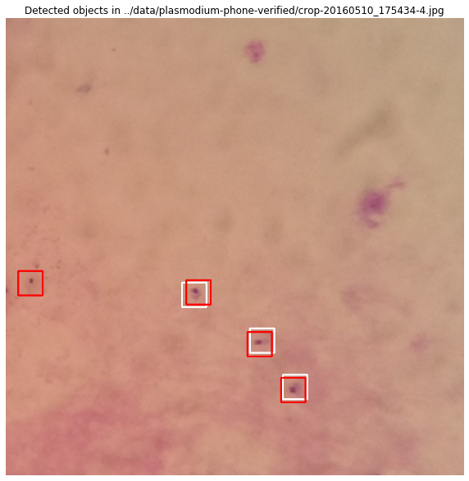
DeepBio 2018
Sample Result-Malaria
White box- labelled by an expert
Red box- Detected by the machine
DEEP CNN FOR MICROSCOPY BASED POINT OF CARE DIAGNOSTICS – John A. Quinn et al. ICMLHC, 2016.

Slide 25
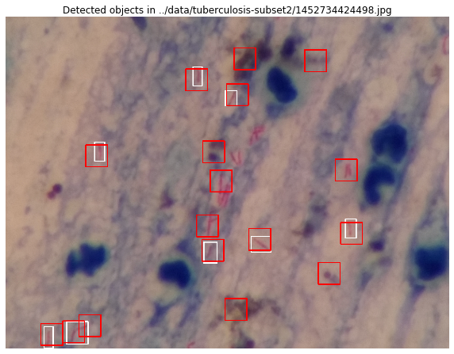
DeepBio 2018
Sample Result-Tuberculosis
White box- labelled by an expert
Red box- Detected by the machine
DEEP CNN FOR MICROSCOPY BASED POINT OF CARE DIAGNOSTICS – John A. Quinn et al. ICMLHC, 2016.

Slide 26
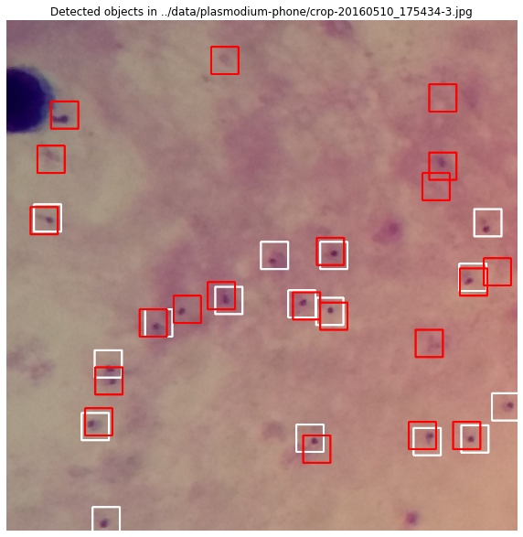
DeepBio 2018
Sample Result-Intestinal Parasites
White box- labelled by an expert
Red box- Detected by the machine
DEEP CNN FOR MICROSCOPY BASED POINT OF CARE DIAGNOSTICS – John A. Quinn et al. ICMLHC, 2016.

Slide 27
DeepBio 2018
Interesting Result-Intestinal
Parasites
DEEP CNN FOR MICROSCOPY BASED POINT OF CARE DIAGNOSTICS – John A. Quinn et al. ICMLHC, 2016.

Slide 28
DeepBio 2018
Summary
Better performance than the hand - engineered features
Flexibility - Same network architecture
Decision support tool
Consistency in diagnosis
DEEP CNN FOR MICROSCOPY BASED POINT OF CARE DIAGNOSTICS – John A. Quinn et al. ICMLHC, 2016.

Slide 29
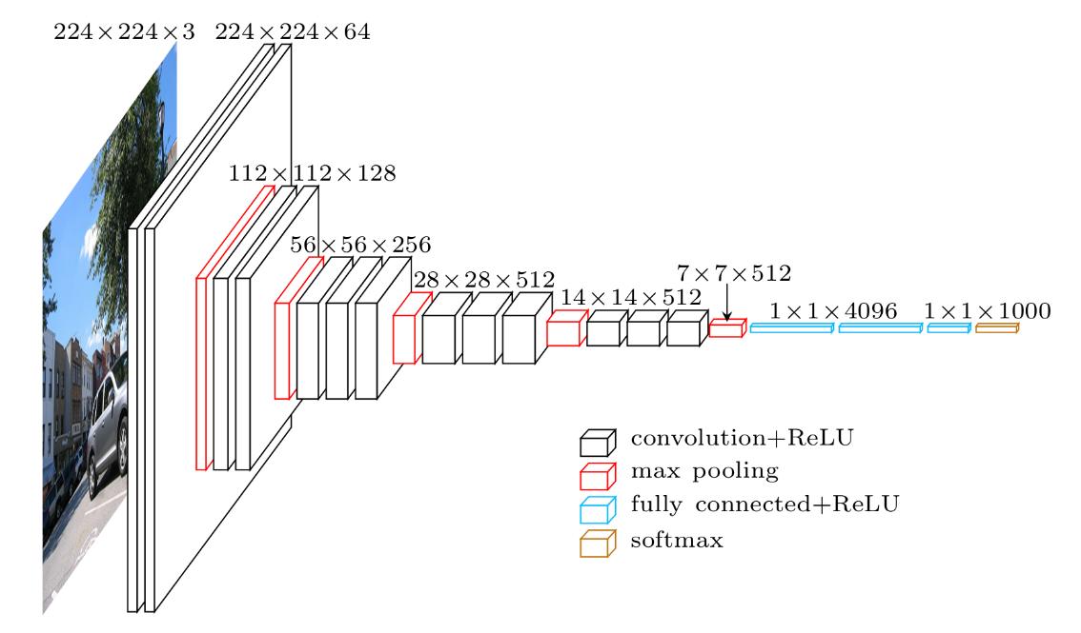
DeepBio 2018
VGG - Net

Slide 30
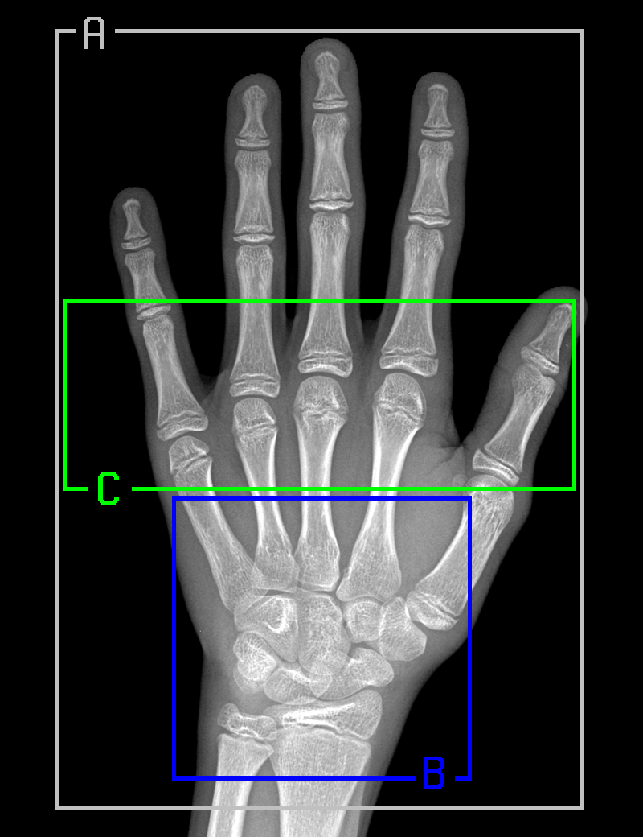
A- Whole Hand (2000 x 1500) B-Carpal Bones (750 x 750) C- Metacarpals and proximal phalanges (600 x 1400)
DeepBio 2018
Pediatric Bone Age Assessment Using Deep Convolutional Neural Networks, bioRxiv preprint first posted online Dec. 14, 2017; doi: http://dx.doi.org/10.1101/234120

Slide 31
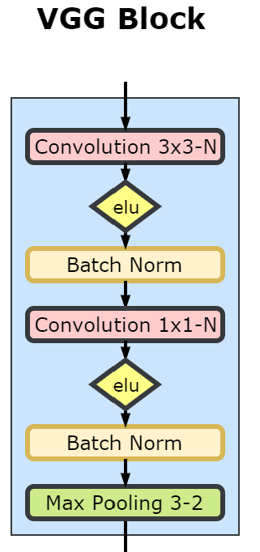
DeepBio 2018
Pediatric Bone Age Assessment Using Deep Convolutional Neural Networks, bioRxiv preprint first posted online Dec. 14, 2017; doi: http://dx.doi.org/10.1101/234120

Slide 32
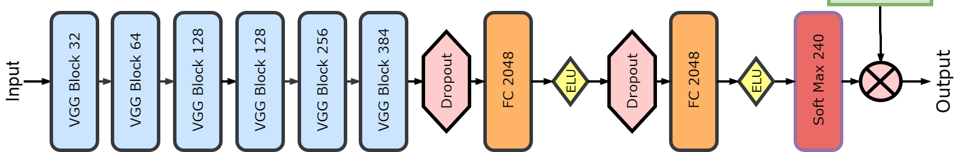
DeepBio 2018
Pediatric Bone Age Assessment Using Deep Convolutional Neural Networks, bioRxiv preprint first posted online Dec. 14, 2017; doi: http://dx.doi.org/10.1101/234120

Slide 33
DeepBio 2018
“Image processing researchers have mixed feelings of disgust and envy towards this recent trend of deep learning that keeps pushing itself into our court. Some of us have chosen to remain bystanders for now, while others play along and divert their research agendas accordingly. I belong to the latter group, with some restrictions. In my opinion, it is impossible to imagine that this wave will pass without a marked influence on our field. Thus, I allow deep learning to influence my research team’s thoughts and actions, but we continue to insist on seeking mathematical elegance and a clear understanding of the ideas we develop.”
Deep, Deep Trouble – Michael Elad, Professor in the Computer Science Department at the Technion – Israel Institute of Technology.
He is editor-in-chief of the SIAM Journal on Imaging Sciences.
[https://sinews.siam.org/Details-Page/deep-deep-trouble]

Slide 34
DeepBio2018
“Health: The Tricorder X price will be announced this year. There are companies who will build a medical device (called the “Tricorder” from Star Trek) that works with your phone, which takes your retina scan, your blood sample and you breath into it. It then analyses 54 biomarkers that will identify nearly any disease. It will be cheap, so in a few years everyone on this planet will have access to world class medical analysis, nearly for free. Goodbye, medical establishment. ”
Must read article on how our lives will change dramatically in 20 years by CEO of Mercedes

Slide 35
DeepBio2018
Bill Gates to students – Dec. 2017
“Artificial Intelligence, Energy and Biosciences make good majors ” .

Slide 36
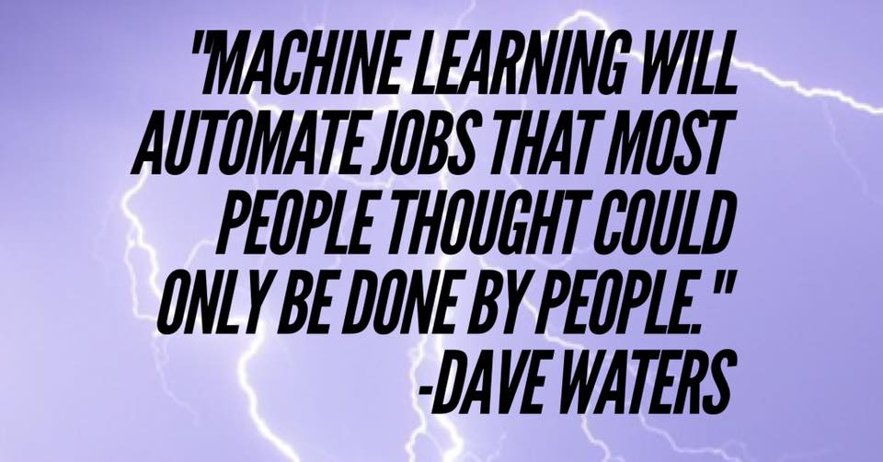
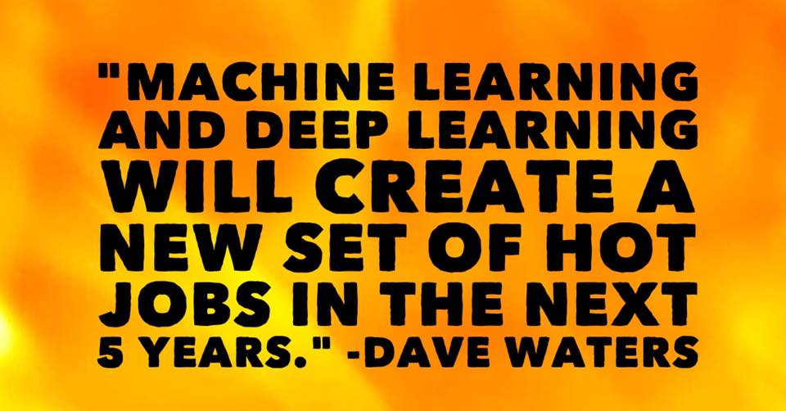

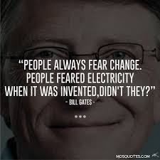
DeepBio 2018

Slide 37


DeepBio 2018

